Slide 1
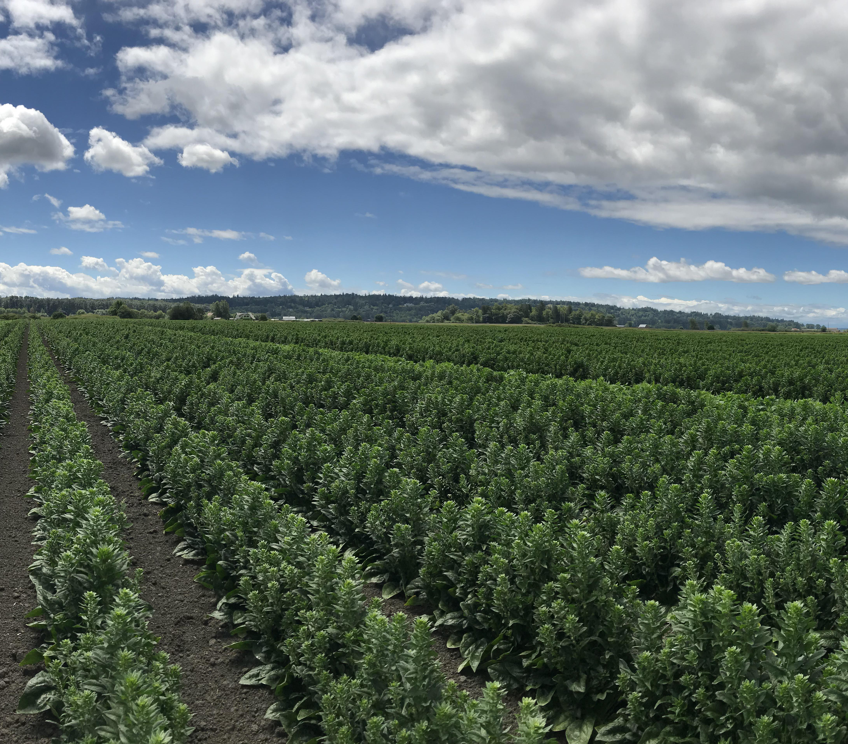
Analysis of state-wise production of food grains and major non-food grains crops in India.
SRIJAN CHAKRAVORTY (RA2011029010001)
ROHIT n. (RA2011029010007)
NAMAN ANAND (RA2011029010013)

Slide 2
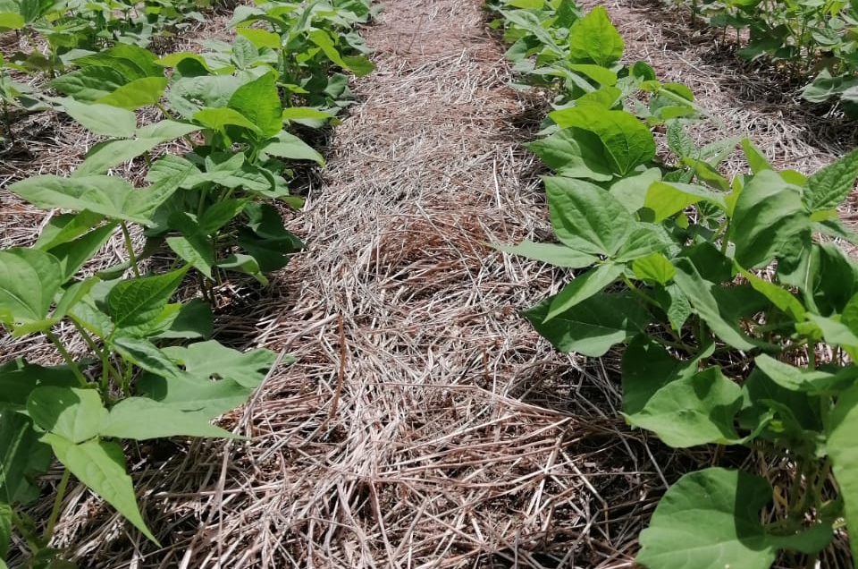

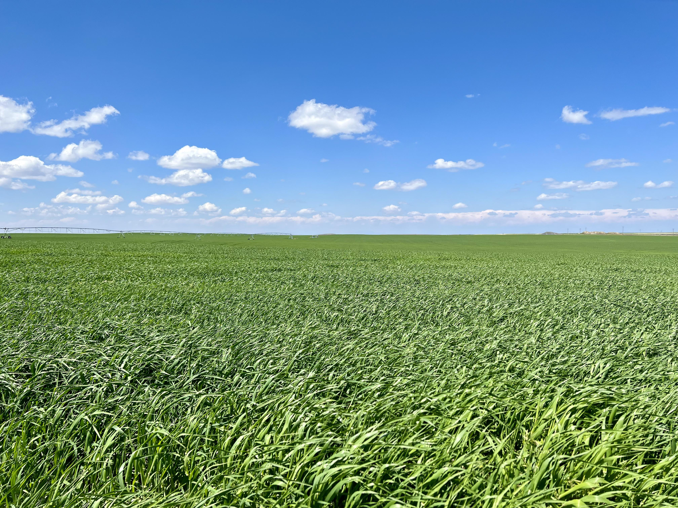
Introduction
The history of agriculture in India dates back to the neolothic. India ranks second worldwide in farm outputs. As per Indian economic survey 2018, agriculture employed more than 50% of the Indian work force and contributed 17–18% to country's GDP. We are pleased to present our findings on the state-wise production of food grains and major non-food grains crops in India. Further the data will be analyzed for patterns in agricultural production across the country to gain insights into the state-wise production of food grains and major non-food grains crops in India.

Slide 3
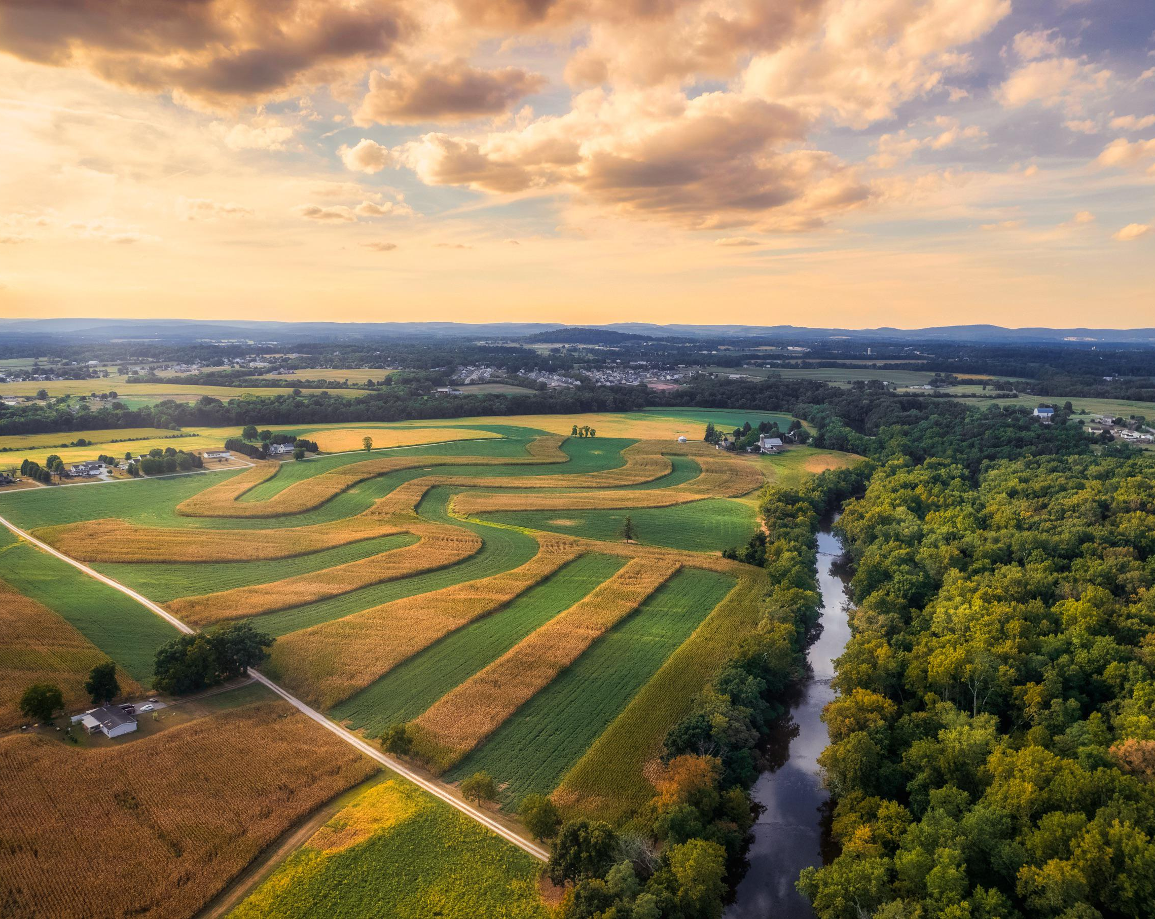
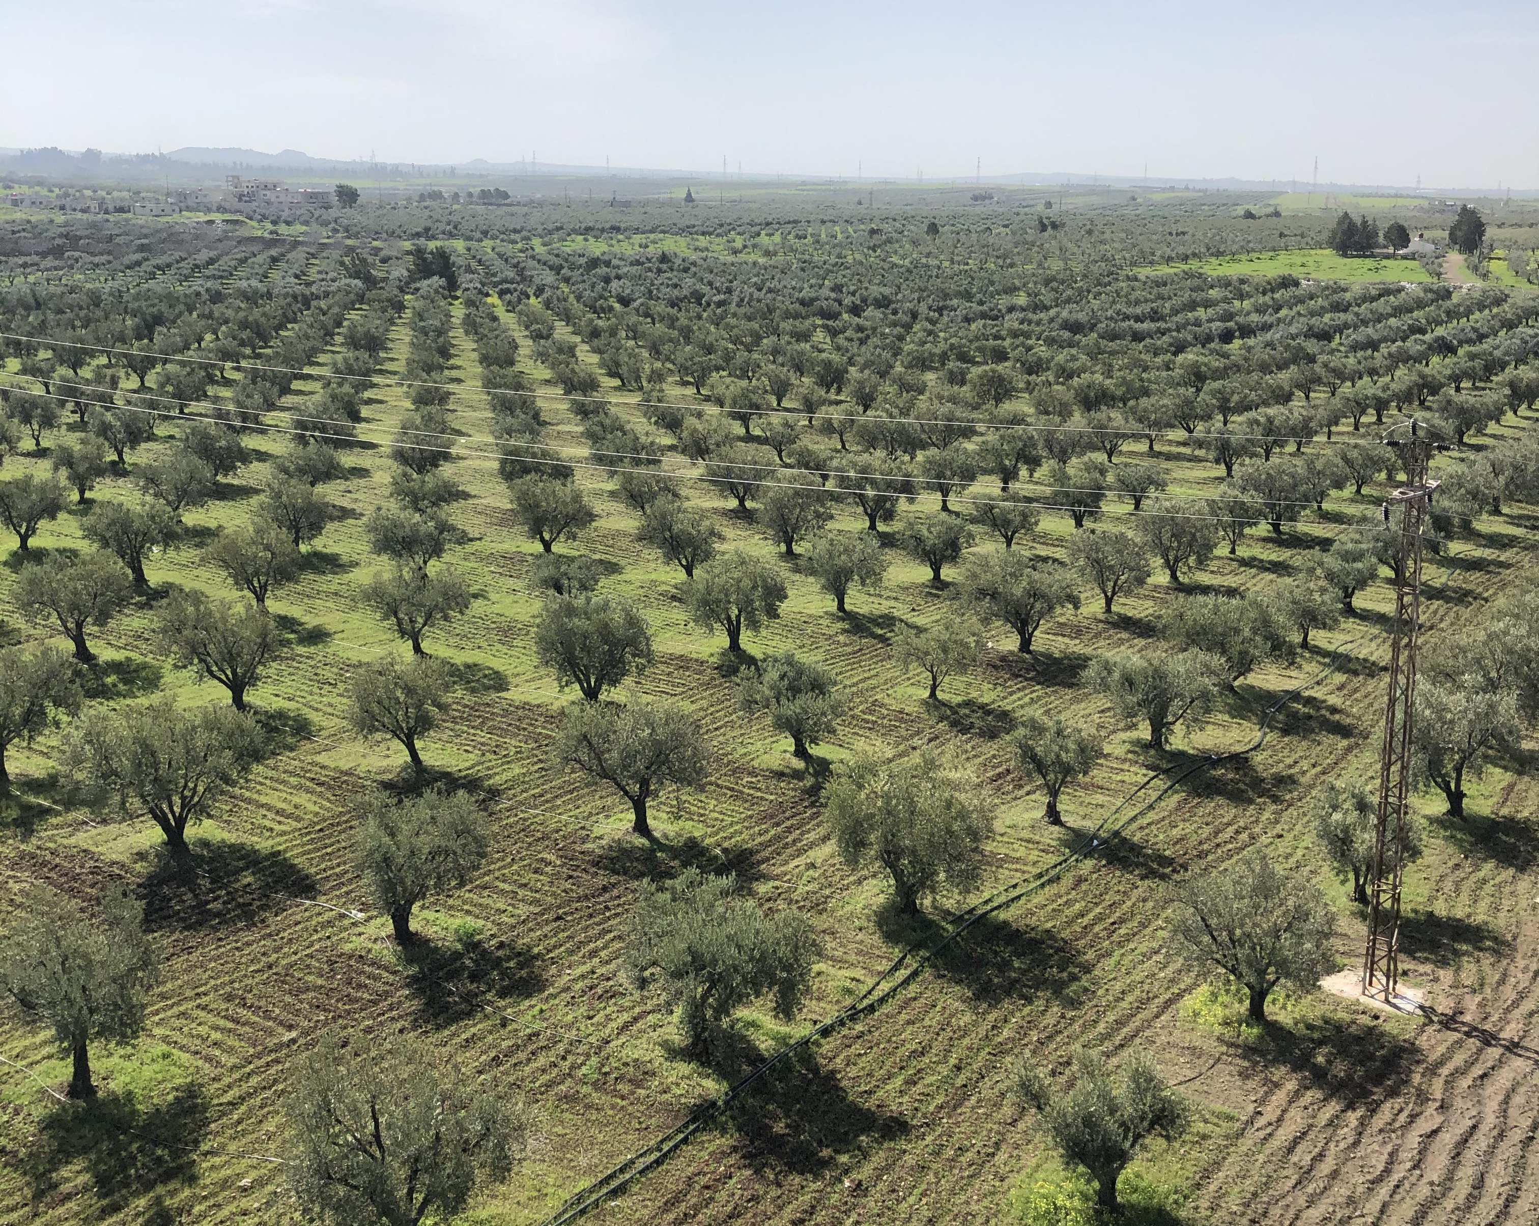

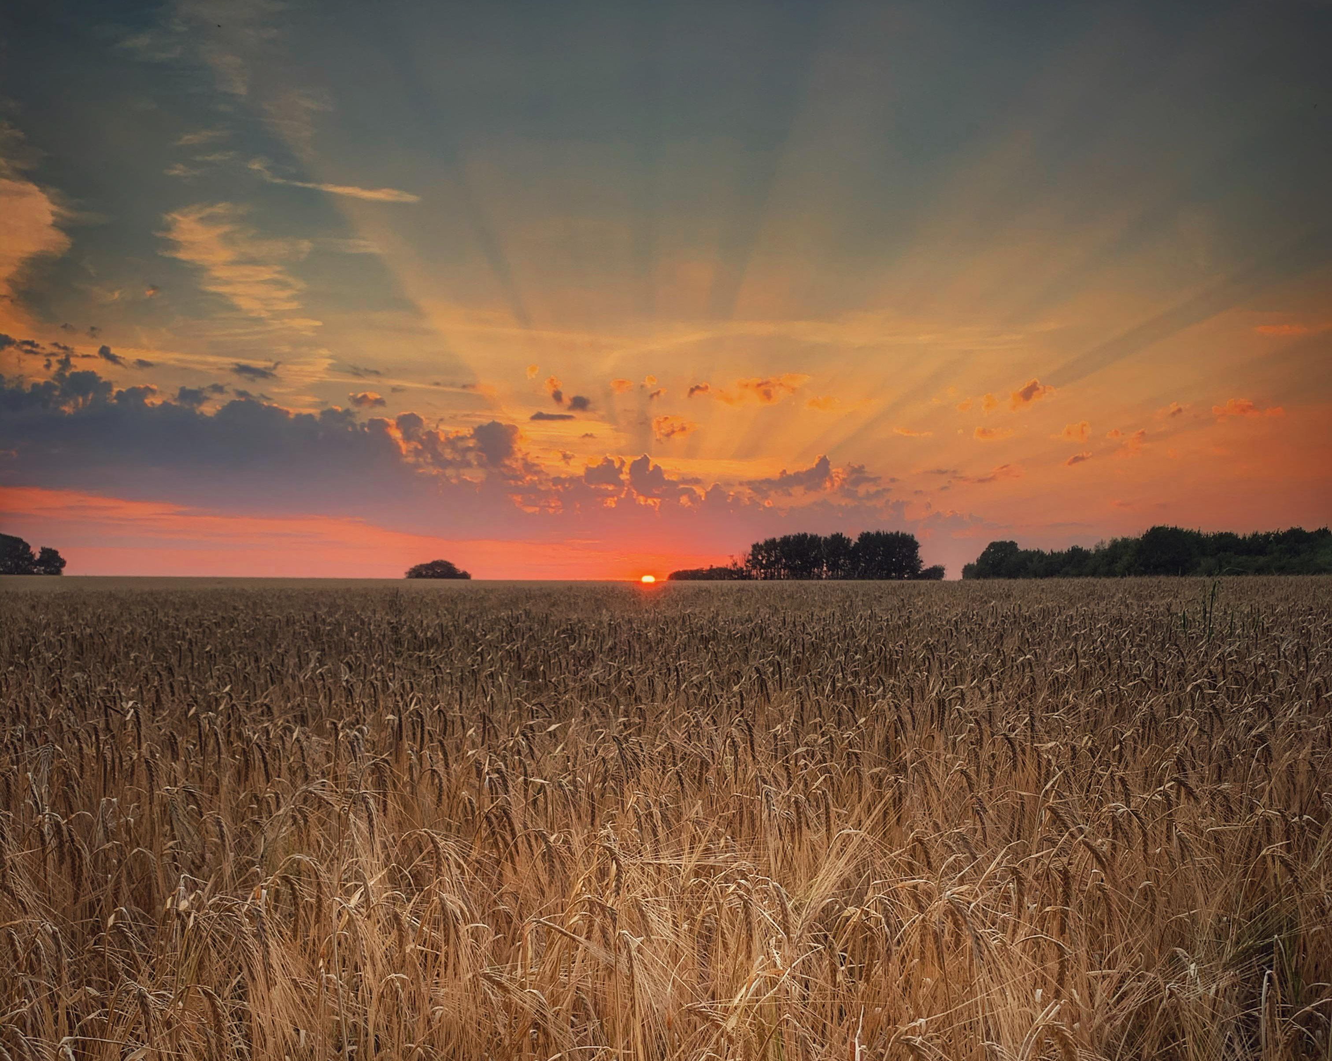
Outline of our presentation.
Data Source and Description
Significance of the Analysis
Who will be able to optimize their operations based on the results of this analysis?
Conclusion

Slide 4
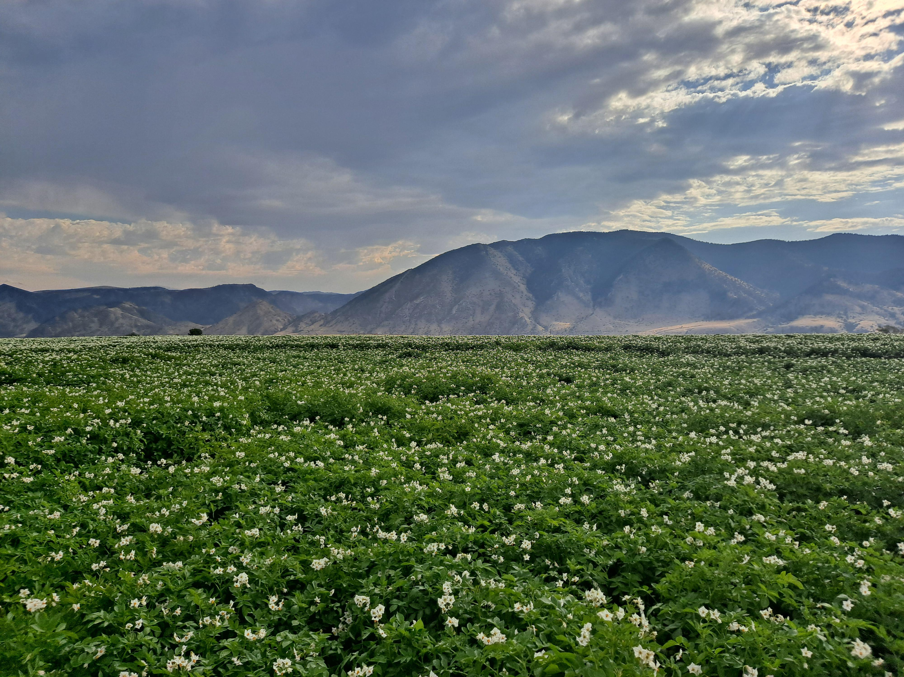
Data Source and Description
The data has been taken from the RBI website, the data is collected by the Ministry of Agriculture & Farmers Welfare, Government of India.
The data contains 627 rows of data and the attributes of the data are the following:
State/Union Territory
Year
Rice Production(in Lakh tonnes)
Wheat Production(in Lakh tonnes)
Coarse Cereals Production(in Lakh tonnes)
Pulses Production(in Lakh tonnes)
Food Grain Production(in Lakh tonnes)
Oil Seed Production(in Lakh tonnes)
Cotton(Lint) Production(in Lakh tonnes)
Sugarcane Production(in Lakh tonnes)
Raw Jute & Mesta Production(in Lakh tonnes)
Link to the dataset

Slide 5
Variable | Variable Type | Description
State/Union Territory | Categorical | Indian state names to which a particular data belongs
Year | Date | Year of collected data
Rice Production(in Lakh tonnes) | Numerical | Shows the production of rice in a particular state over a given period of time.
Wheat Production(in Lakh tonnes) | Numerical | Shows the production of rice in a particular state over a given period of time.
Coarse Cereals Production(in Lakh tonnes) | Numerical | Shows the production of rice in a particular state over a given period of time.
Pulses Production(in Lakh tonnes) | Numerical | Shows the production of rice in a particular state over a given period of time.
Food Grain Production(in Lakh tonnes) | Numerical | Shows the production of rice in a particular state over a given period of time.
Oil Seed Production(in Lakh tonnes) | Numerical | Shows the production of rice in a particular state over a given period of time.
Cotton(Lint) Production(in Lakh tonnes) | Numerical | Shows the production of rice in a particular state over a given period of time.
Sugarcane Production(in Lakh tonnes) | Numerical | Shows the production of rice in a particular state over a given period of time.
Raw Jute & Mesta Production(in Lakh tonnes) | Numerical | Shows the production of rice in a particular state over a given period of time.

Slide 6
Significance of the Analysis
Food Security
Market Analysis
The analysis is important for ensuring food security by providing information on the availability of different crops in different regions. By analyzing the historical data, policymakers can identify regions that are most vulnerable to food shortages and develop policies to address these issues.
The historical analysis can be used to analyze market trends and forecast future demand for different crops. This information can be used by traders and investors to make informed decisions about crop pricing, storage, and transportation.

Slide 7
Significance of the Analysis
Policy Planning
The historical analysis can help to implement effective agricultural policies by providing insights into production trends, yield gaps, and the performance of different regions. For example, if a particular state consistently produces more rice than wheat, policymakers can develop policies to encourage rice production in that state.

Slide 8
Who will be able to optimize their operations based on the results of this analysis?
Farmers
Agribusinesses
The analysis can help farmers make informed decisions about crop selection, land use, and resource management. By analyzing the data, farmers can identify the most suitable crops for their region and optimize their production practices accordingly.
The analysis can help agribusinesses analyze market trends, forecast demand for different crops, and make informed decisions about pricing, storage, and transportation

Slide 9
Who will be able to optimize their operations based on the results of this analysis?
Researchers
Investors
The analysis can help researchers identify trends and patterns in crop production, analyze the impact of climate change on agriculture, and develop new technologies and practices to improve crop yields and sustainability.
The analysis can help investors identify profitable opportunities in the agricultural sector, such as investing in new technologies, crops, or regions that have a high potential for growth.

Slide 10
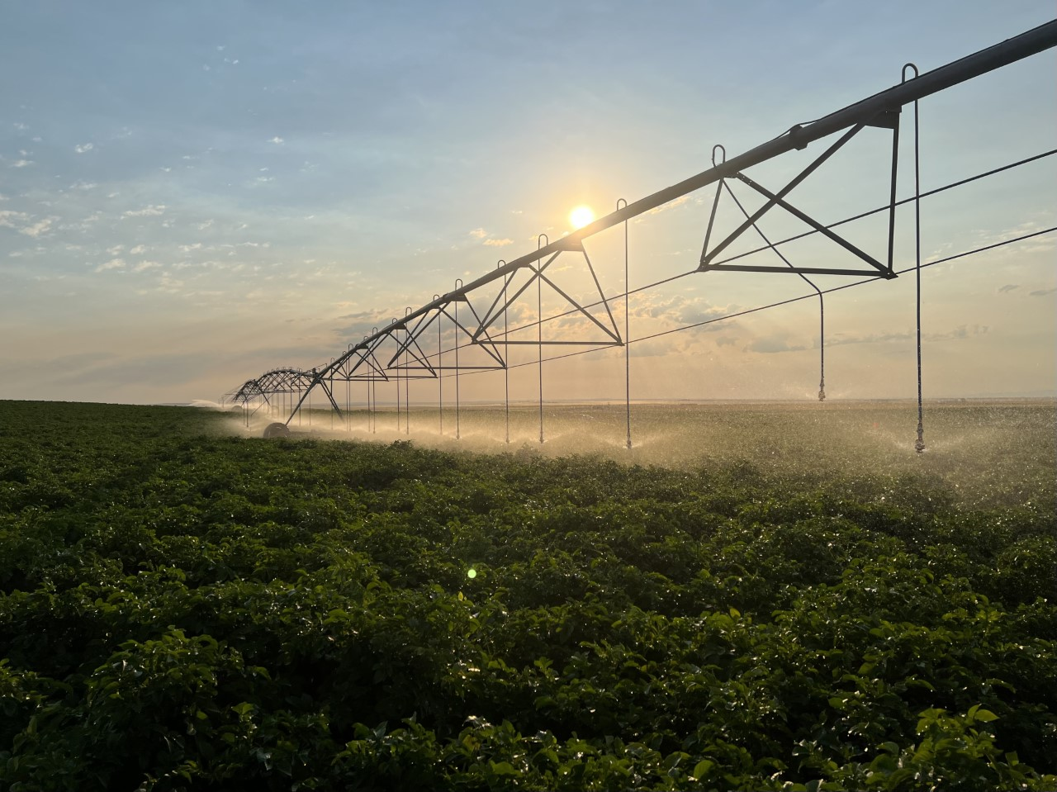
Conclusion
At the end of the analysis, we will be able to analyze the production of different crops in different states efficiently. Data visualization on the dataset of state-wise production of food grains and major non-food grain crops in India can play a crucial role in informing decision-making, promoting growth, and achieving sustainable agricultural development.

Slide 11

Thank you

